Slide 1


MARKETING
PERFORMANCE
ANALYSIS

Slide 2
WHO WE ARE ?
WHO WE ARE ?
MALAK WAHIED
MARIAM AHMED
RAHMA MAHMOUD
HAGER MUSTAFA

Slide 3
INTRODUCTION:
•This project aims to clean, analyIse, and interpret performance marketing data to gain a deeper understanding of key trends and patterns
•The final dashboard will serve as a comprehensive tool to communicate these findings effectively, highlighting correlations, anomalies, and emerging trends.
•Performance Marketing is a new and emerging field within the marketing industry and is predicted to be the biggest type of marketing in the future. Data and projects based on this concept are still quite limited despite the increasing demand for it by companies.
.

Slide 4




OUR TOOLS :
EXCEL
MY SQL
python
Power bi

Slide 5
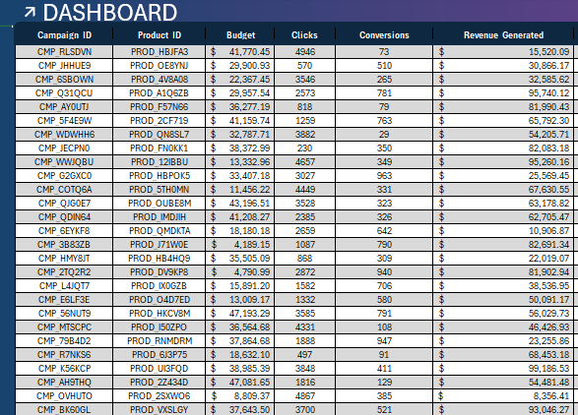
EXCEL :
Cleaning :
The data was exceptionally clean, meaning it was free from common issues such as missing values, inconsistencies, or formatting errors that often require preprocessing. Additionally, there were no duplicate entries, which ensured the integrity and reliability of the dataset. When I utilized the pivot query to explore and summarize the data, I found that it was already well-structured and organized

Slide 6
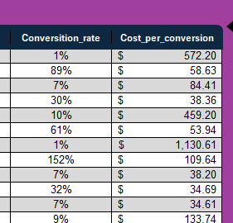
EXCEL :
Preprocessing :
enhanced the dataset by adding two new columns to provide deeper insights:
1- Conversion Rate:
The formula used is =[@Conversions] /[@Clicks]
This allowed me to express the conversion efficiency as a percentage
2-Cost per Conversion:
The formula for this metric is =[@Budget] / [@Conversions]
] This metric helped in assessing the financial performance of the conversion process
.Additionally, I refined the formatting of the dataset’s columns to improve clarity. For example, I formatted the Revenue column to include a dollar sign (e.g., $1,234.56) for clear financial representation. The Conversion Rate column was formatted to display as a percentage (e.g., 25.00%) to align with standard reporting practices.

Slide 7
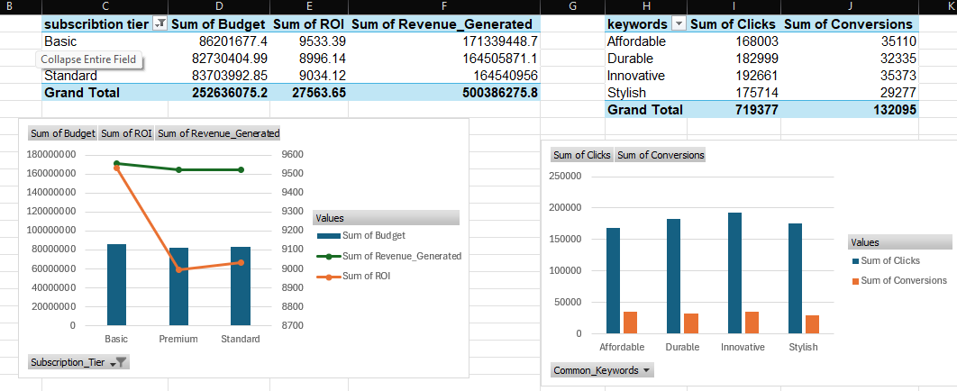
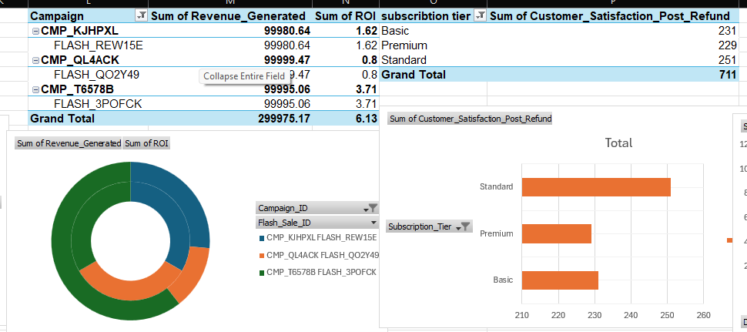
EXCEL :
Revenue, Budget, ROI by Subscription tier: Pivot table showing Profit, Cost, and ROI per subscription, visualized with a Combo Chart (columns for Profit/Cost, line for ROI).
Clicks and Conversions by common Keywords: Pivot table for Clicks and Conversions of the most common keywords, shown in a Column Chart.
Analysis :
Top 3 Campaigns by Profit and ROI: Pivot table for the top 3 campaigns by Profit and ROI, visualized with a Donut Chart.
Satisfaction Refund by Subscription: Pivot table for Satisfaction Refund per subscription, displayed in a Horizontal Bar Chart.

Slide 8
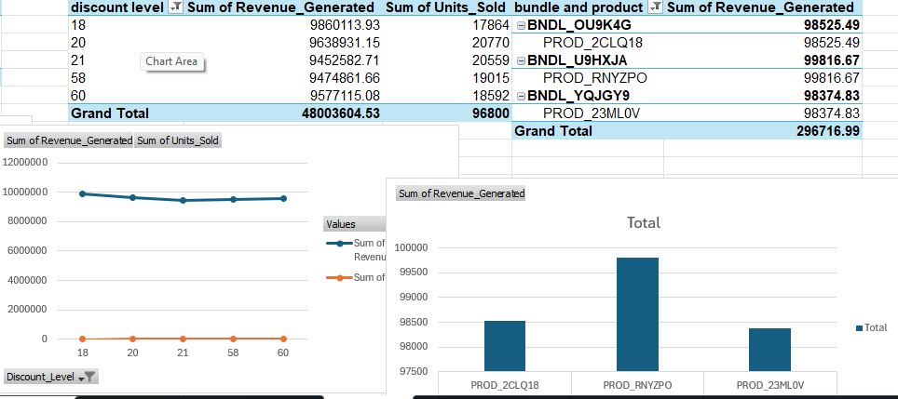
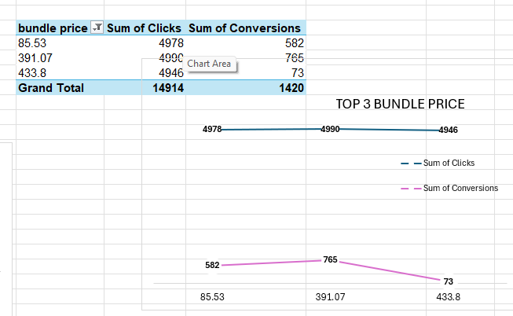
EXCEL :
Top 5 Discounts by Profit and units : Pivot table for the top 5 discounts by Profit and Sales, shown in a Line
Top 3 Bundles/Products by Profit: Pivot table for the top 3 bundles/products by Profit, visualized in a Column Chart.
Analysis :
Top 3 Bundle Prices by Clicks and Conversions: Pivot table for the top 3 bundle prices by Clicks and Conversions, displayed in a Line chart

Slide 9
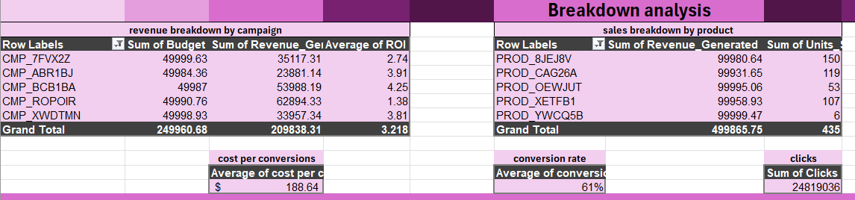
EXCEL :
Analysis :
You can see the pivot tables of breakdown analysis for revenue breakdown by campaign / sales breakdown by product / cost per conversion / conversion rate/ clicks / ROI

Slide 10
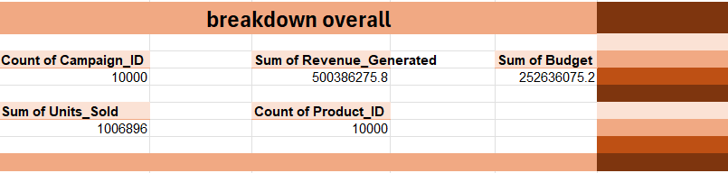
EXCEL :
Analysis :
And also you can see the breakdown overall :
Count of campaigns/ revenues/ budgets/ units / products

Slide 11
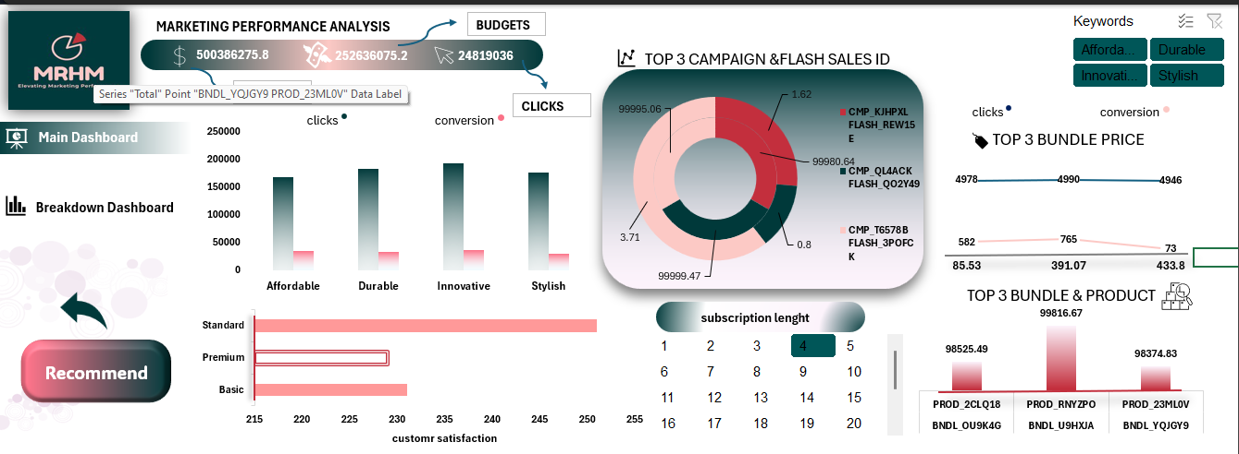
EXCEL :
Visualization :

Slide 12
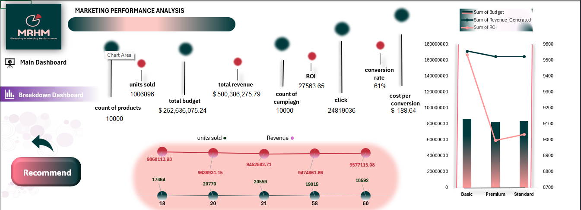
EXCEL :
Visualization :

Slide 13
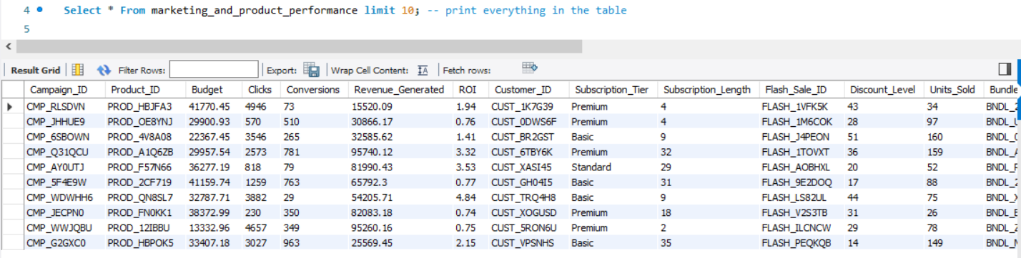
MY SQL:
DATA RETRIEVAL:
What I did:
Loaded pre-cleaned data from Excel into SQL
Verified all columns were imported correctly
Confirmed data types matched the cleaned Excel format
Verified column data types matched expectations
Checked for obvious anomalies
Key Benefits:
Ensured analysis starts with accurate, consistent data
Reduced time spent cleaning data within SQL
Quick understanding of available data fields
Early detection of potential data quality issues

Slide 14
MY SQL:
BASIC METRICS :
What I did:
Calculated foundational KPIs (total campaigns, revenue, budget)
Computed averages (conversion rate, ROI, profit margin)
Key Benefits:
Established performance benchmarks
Identified whether numbers matched business expectations

Slide 15
MY SQL:
SEGMENT ANALYSIS :
What I did:
Grouped data by meaningful categories (discount tiers, subscription types)
Compared performance across segments
Key Benefits:
Revealed which customer/product segments perform best
Highlighted opportunities for targeted improvements

Slide 16
MY SQL:
PERFORMANCE RANKING :
What I did:
Identified top/bottom 10 campaigns by key metrics
Flagged high-performing products and customers
Key Benefits:
Clear visibility into what's working vs. what's not
Data-driven resource allocation decisions

Slide 17
MY SQL:
PROBLEM DETECTION :
What I did:
Found campaigns with high clicks but low conversions
Analyzed discount impact on profit margins
Key Benefits:
Pinpointed optimization opportunities
Prevented wasteful spending on ineffective strategies

Slide 18
MY SQL:
ACTIONABLE INSIGHTS :
What I did:
Developed specific recommendations based on findings
Created clear next steps for marketing team
Key Benefits:
Transformed raw data into executable strategies
Aligned analysis with business objectives

Slide 19
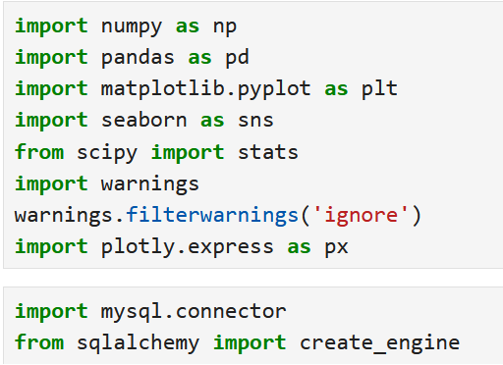
Python:
LIBRARIES USED :
pandas (pd) - Core data manipulation (DataFrames, SQL queries, calculations)
numpy (np) - Numerical
sqlalchemy - Database
mysql-connector - MySQL
matplotlib.pyplot (plt) - Basic visualization.
seaborn (sns) - Statistical
plotly.express (px) - Interactive
scipy - Scientific
warnings - Alert management

Slide 20
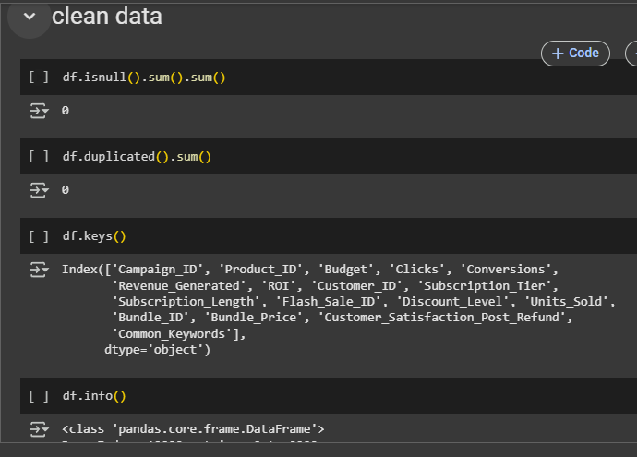
Python:
Cleaning :
-Checks for missing values in the Data. The result is 0, meaning there are no missing values.2.
-Checks for duplicate rows. The result is 0, confirming no duplicates exist.
-Lists the column names of the Data, which include the metrics
-Displays the structure of the Data, confirming it’s a Pandas Data with the listed columns and their data types
.Summary of Operations: The code verifies that the dataset is clean (no missing values or duplicates) and provides an overview of its structure and columns, preparing it for further analysis.

Slide 21
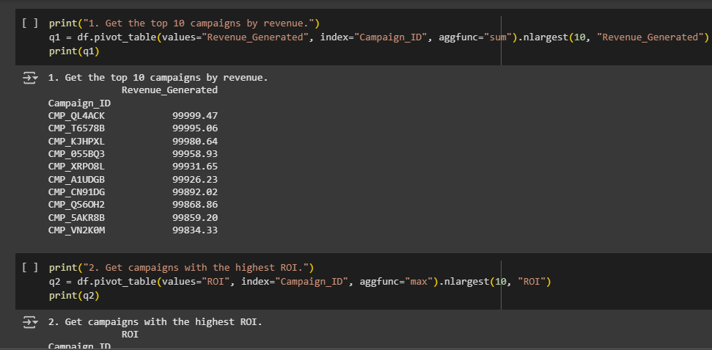
Python:
Preprocessing :
When writing a pivot_table in Pandas:
First: Choose the values to aggregate (e.g., values='REVENUE_GENERATED')—this defines the data to summarize
Second: Choose the index (e.g., index='CAMPAIGN_ID')—this becomes the rows of the table
Third: Specify the aggregation function (e.g., aggfunc='sum’)
this defines how to summarize the data (like summing revenue).This creates a table summarizing the values for each index entry, with optional sorting to focus on top results.

Slide 22
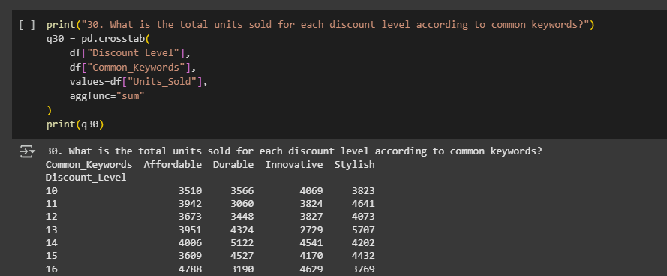
Python:
Preprocessing :
When writing a crosstab in Pandas:
First: Choose the row variable (e.g., df['Discount_Level'])—this becomes the rows of the table
Second: Choose the column variable (e.g., df['Common_Keywords'])—this becomes the columns of the table.
Third: Specify the values to aggregate (e.g., values=df['Units_Sold']) and the aggregation function (e.g., aggfunc='sum’)
this defines what data to summarize and how (like summing units sold).This creates a table showing the relationship between the two variables with the aggregated values.

Slide 23
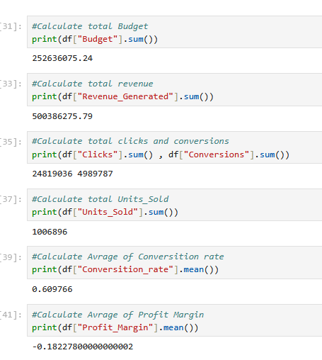
Python:
Analysis :
What I did:
Cross-checked statistical distributions
Validated business logic consistency
Ensured temporal coherence (if time-based data)
Confirmed key metric calculations
Quality Checks:
Budget = SUM(Campaign budgets)
Revenue >= 0 for all records
Conversion rates within 0-100% range
ROI calculations mathematically valid
Result:
All data passed quality thresholds
No logical inconsistencies found- Ready for analysis phase

Slide 24
Python:
Visualization :
What I did:
Cross-checked statistical distributions
Validated business logic consistency
Ensured temporal coherence (if time-based data)
Confirmed key metric calculations
Quality Checks:
Budget = SUM(Campaign budgets)
Revenue >= 0 for all records
Conversion rates within 0-100% range
ROI calculations mathematically valid
Result:
All data passed quality thresholds
No logical inconsistencies found- Ready for analysis phase

Slide 25
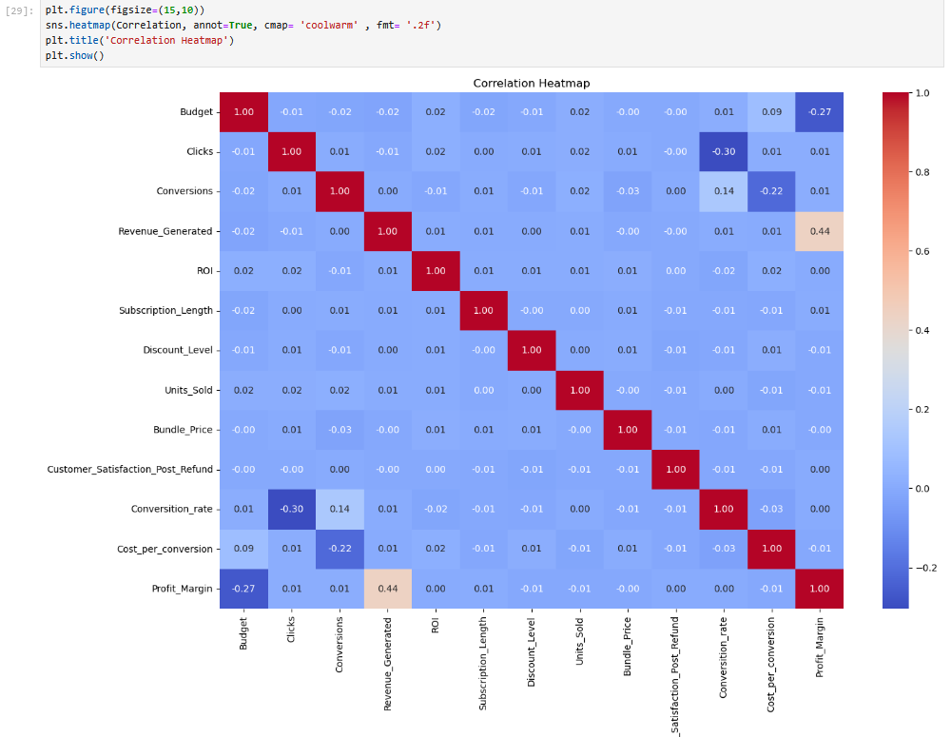
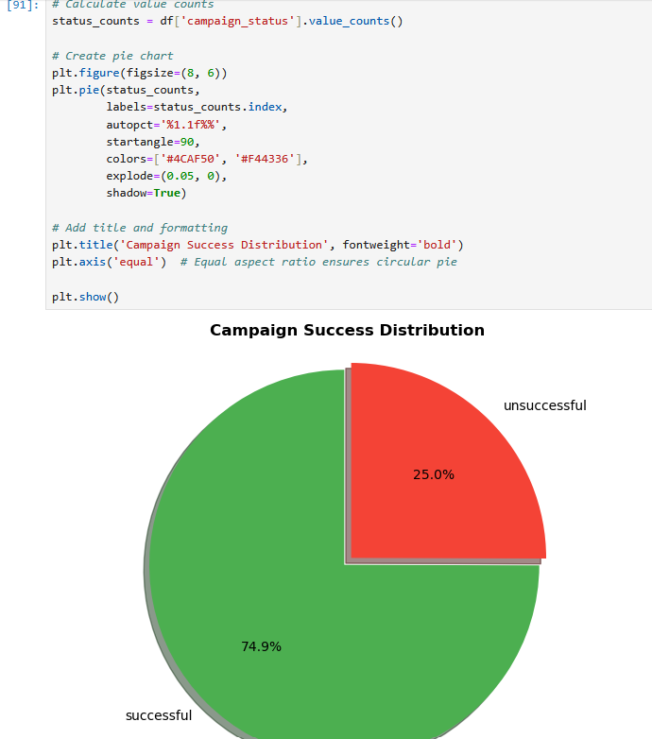
Python:
Visualization :
Distribution Plots:
- Used: sns.histplot(), plt.boxplot()
- Purpose: Analyzed metric distributions (Profit_Margin, ROI)
Example:
Verified normal distribution of conversion rates
2. Relationship Plots: - Used: sns.scatterplot(), px.scatter_3d()
Purpose: Examined correlations between: * Budget vs. Revenue * Discounts vs. Conversions * Clicks vs. Profit (3D)3.
Comparison Charts: - Used: sns.barplot(), px.pie() - Purpose: Compared performance across: * Subscription tiers * Campaign categories * Success vs. Failed campaigns

Slide 26
Power bi :
Components:
Home Page: This page is the first one that you see when you open Power BI and it shows the company logo and links to the dashboards.
Who are we page: A page that explains the company and what services we offer.
Dashboards: We have two main dashboards: Customer & Subscription Behavior and also Marketing & Sales Performance. Each dashboard focuses on a different part of the data.
Recommendations Page: The final page that shows insights and recommendations based on our dashboards

Slide 27
Power bi :
Features Used:
Tooltip: Three gauge graphs appear when hovering over graphs that shows comparison between our chosen category and the full data.
Drill down Graph: this allows for more detail and therefore more comprehensive understating of our data.
Buttons:
Light/ Dark mode buttons: The page colors changes when you press on it
Navigation buttons: the buttons allow you to easily navigate between pages in your dashboard
Clear filters button: allows us to easily clear all filters on the page so we can see how it originally was.

Slide 28
Power bi :
KPI & DAX:
Total Revenue = SUM(marketing_and_product_performan[Revenue_Generated])
Average ROI = AVERAGE(marketing_and_product_performan[ROI])
Average Customer Satisfaction = AVERAGE(marketing_and_product_performan[Customer_Satisfaction_Post_Refund])
Total Units Sold = SUM(marketing_and_product_performan[Units_Sold])
Total Budget = SUM(marketing_and_product_performan[Budget])
Average Conversion Rate = AVERAGE(marketing_and_product_performan[Conversion_rate])
Average Discount Level = AVERAGE(marketing_and_product_performan[Discount_Level])
Average CPC = AVERAGE(marketing_and_product_performan[Cost_per_conversion])
Number of Campaigns = COUNT(marketing_and_product_performan[Campaign_ID])

Slide 29
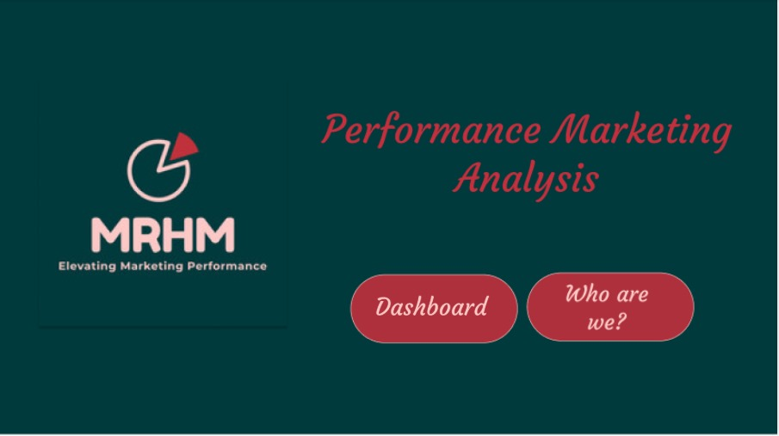
Power bi :

Slide 30

Power bi :

Slide 31
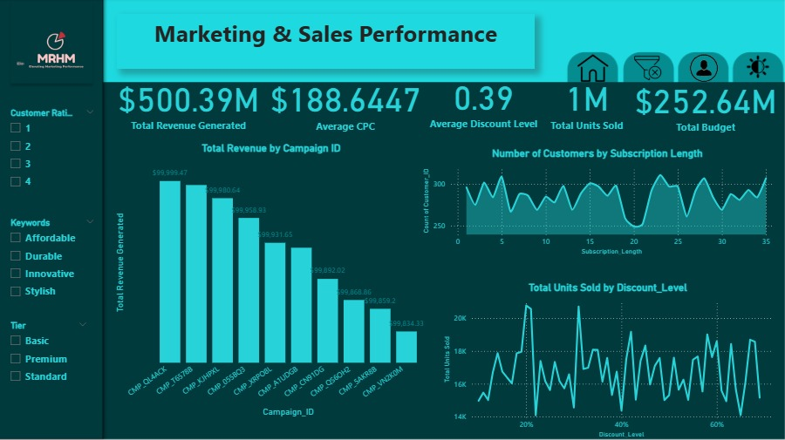
Power bi :

Slide 32
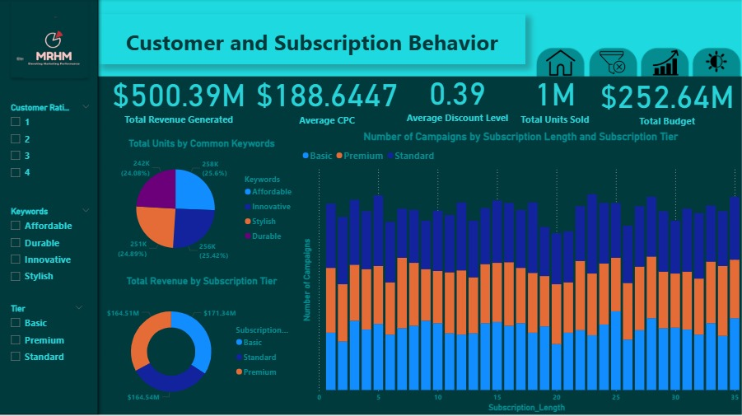
Power bi :

Slide 33

Recommendations
Recommendations
4. Tailor Offers by Subscription Tier
Why: Average subscription length is about the same (~18 months) across all tiers.
What to do: Use tier-based promotions to upsell from Basic and Standard to Premium, since all stay loyal for a similar time.
5. Use High-Converting Flash Sale Templates
Why: Some Flash_Sale_IDs consistently lead to 999 conversions, which is the maximum seen.
What to do: Replicate the structure and timing of these successful flash sales in future campaigns.
6. Improve Post-Refund Satisfaction
Why: Satisfaction is evenly spread between ratings of 1 to 4, with no one score clearly dominant.
What to do: Investigate pain points in the refund process and improve post-sale support to shift scores toward 5.
7. Double Down on Winning Keywords
Why: The most frequent keywords are:
"Affordable" (2559 times),
"Stylish" (2514),
"Innovative" (2491).
What to do: Prioritize these terms in ads and SEO; they likely align well with customer expectations and drive engagement.
1. Reallocate Budget Based on ROI
Why: ROI ranges from 0.5 to 5.0, with a median of 2.75, showing significant variation. Some campaigns yield much better returns for similar budgets.
What to do: Identify and invest more in high-ROI campaigns, and audit or scale down low-ROI ones.
2. Address Low Conversion Efficiency
Why: The average conversion rate is only 0.61, but some campaigns with very high clicks (e.g., 4946) achieve very few conversions (e.g., 73).
What to do: Audit underperforming campaigns with high clicks but low conversion rates to improve landing pages or targeting.
3. Optimize Product Bundling
Why: The correlation between Bundle_Price and Units_Sold is almost zero (-0.0025), suggesting price is not a major driver.
What to do: Focus on the value perception and relevance of the bundles rather than just price.

Slide 34
Conclusion:
This project uncovered key insights into subscription performance through clean data preprocessing and metrics
All in all, this was a fun and insightful dive into the data. We dug up clear results and practical ideas to focus on what really works, like the top keywords, offers, and campaigns. The data was clean and ready, making it easy to spot the key stats. Let’s roll with these insights and level things up!

Slide 35
ANY QUESTIONS ?

Slide 36

THANK YOU

